Slide 1

COLEMAN
HEAT PUMPS
Feller heating
2019 Coleman heat pump Line up

Slide 2
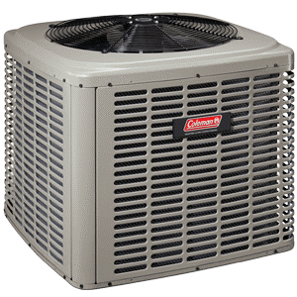
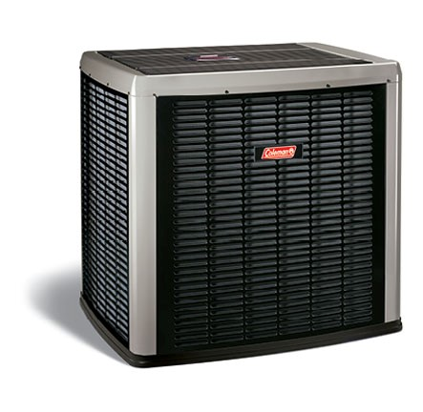
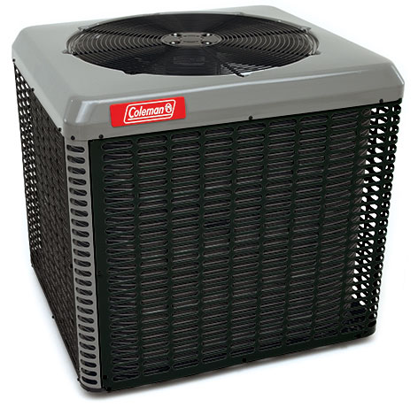
2018 COLEMAN HEAT PUMPS
TH4B 14 SEER HP
CH16 16 SEER HP
HC20 20 SEER HP
Coleman's workhorse heat pump - dB 70-75
Solid, reliable performance
Up to 14.5 SEER & 9.0 HSPF
Warranty – Limited 10 year compressor / 10 year parts
Efficient 5-stage compressor adjusting output to your heating & cooling needs
Up to 16 SEER & 10 HSPF
Warranty – Limited 10 year compressor / 10 year parts
Coleman’s 1st Inverter Driven Heat Pump, never gives you more than you need!
Efficient compressor adjusting output to your heating & cooling needs
Up to 20 SEER & 11 HSPF
Warranty – Limited lifetime compressor / 10 year parts

Slide 3
Heat Pump Staging Differences
TH4B SINGLE STAGE
CH16B 5-STAGE MODULATING
HC20 INVERTER MODULATING
Single stage compressor Satisfies the degree of comfort you need
Unit has one fan speed, runs at 100% capacity every time unit comes on
Small footprint cabinets deliver max performance that is both space and budget friendly
Minimal vibration noise thanks to quiet drive fan blade design
50-60% savings on energy bill compared to furnace-only operation
Enjoy efficient modulating compressor technology that reduces capacity to match your comfort level
Unit has 5 speeds; turns on at 2nd stage and ramps up or down, depending on what you need
Unit learns over time heating/cooling patterns, and turns on at capacities it realizes you need
Only gives you as much as you need, saving money by not wasting energy created that is not needed
60-70% savings on energy bill compared to furnace-only operation
Coleman’s most efficient heat pump, and on of the most efficient and quietest on the market
Longer run time at lower capacities allow for even heating throughout the house along with lower energy bills
Enjoy efficient modulating compressor technology that reduces capacity to match your comfort level
Unit learns over time heating/cooling patterns, and turns on at capacities it realizes you need
Only gives you as much as you need, saving money by not wasting energy
70-80% savings on energy bill compared to furnace-only operation

Slide 4
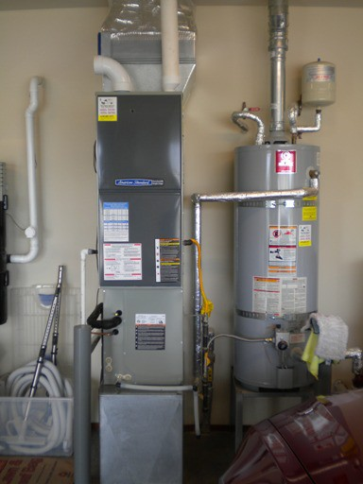
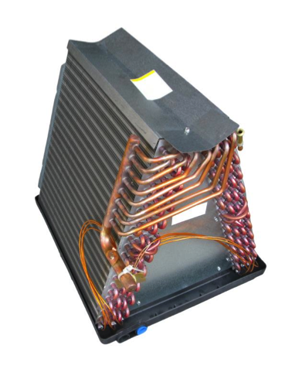
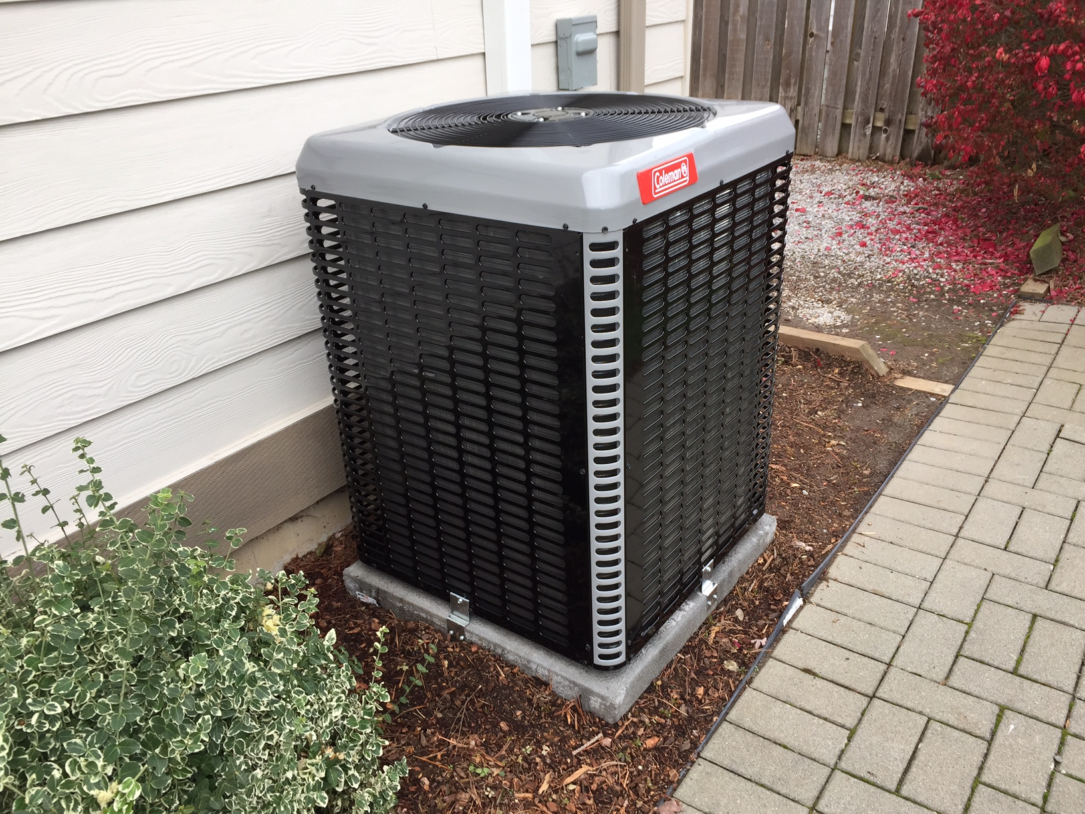
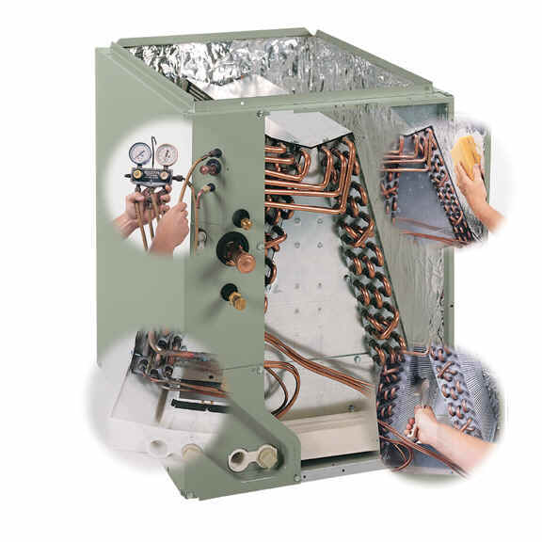
What to Expect Your System Will Look Like
Coleman Heat Pump Outdoor Compressor set on lightweight concrete pad
4” thickness – styrofoam dipped in durable concrete
Coleman Furnace/Heat Pump set up on the interior
Furnace with a Coil attached – below furnace for downflow, above furnace for upflow
Adds another 20-33” to the height of your system
Coleman Coil – Connects the heat pump compressor outside to the furnace inside
Coil heats up from hot refrigerant during heating mode, cools from cold refrigerant during AC mode
Furnace uses fan function to blow return air across hot/cold coil through the existing ductwork into the home/system

Slide 5

HEAT PUMP BENNIFITS
Heat Pumps are super energy efficient - over 60% less to operate than some existing systems.
Heat Pumps are safe
Heat Pumps provide “Both” Heating & Cooling to your home
Heat Pumps improve air quality by the amount of air that is filtered through a heating / cooling cycle.
Heat Pumps create more even heating / cooling temperatures by delivering longer run times than traditional heating equipment.
Heat Pumps are Utility rebate friendly
$350 or $800 Puget Sound Energy Rebates Available

Slide 6
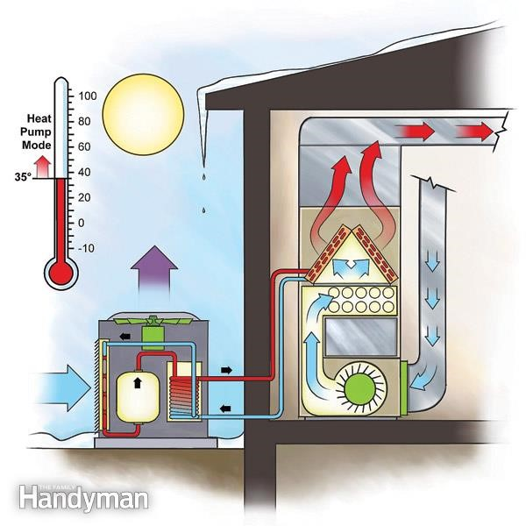
HOW HEAT PUMPS WORK
A Heat Pump moves heat from one source to another
A fan pulls the outside air over liquid refrigerant filled coils the liquid in the coils absorbs the heat in the air and expands to a hot vapor
This vapor is put through a compressor which increases the pressure and temperature of the gas, and the vapor flows to the indoor coil.
The indoor furnace fan distributes the heat off the coil into the home and the refrigerant condenses back into a liquid as it cools and flows back outside to pick up more heat.
When in AC mode the system reverses and pulls heat out of the refrigerant turning it into a cold liquid which is then pumped to the indoor coil to deliver cool air in the home.

Slide 7

Coleman CH16 & HC20
Modulating Heat Pump Benefits
Changing weather outside can lead to big fluctuations in your home’s comfort system inside. Traditional heat pumps operate in on or off cycles, which use considerable amounts of electricity and can create uncomfortable fluctuations in temperature
The inverter-driven modulating technology helps keep your energy bills low by varying capacity to more closely match your space requirements. Traditional one or two stage systems may produce more capacity than is required as conditions change. A modulating system provides only what is actually needed to condition the space. This helps avoid fluctuating temperatures while reducing energy consumption.

Slide 8
Whisper Drive Technology (CH16)
WhisperDrive System is the name of design elements Coleman Echelon products use to achieve low sound ratings.
This includes Swept-Wing fan design (the U.S. Navy uses similar design on it’s submarines)
An isolated compressor compartment referred to as “the doghouse” is a composite base pan (rubberized) so it absorbs compressor noise.

Slide 9
Coleman Heat Pump Dimensions
TH4B
CH16
HC20

Slide 10
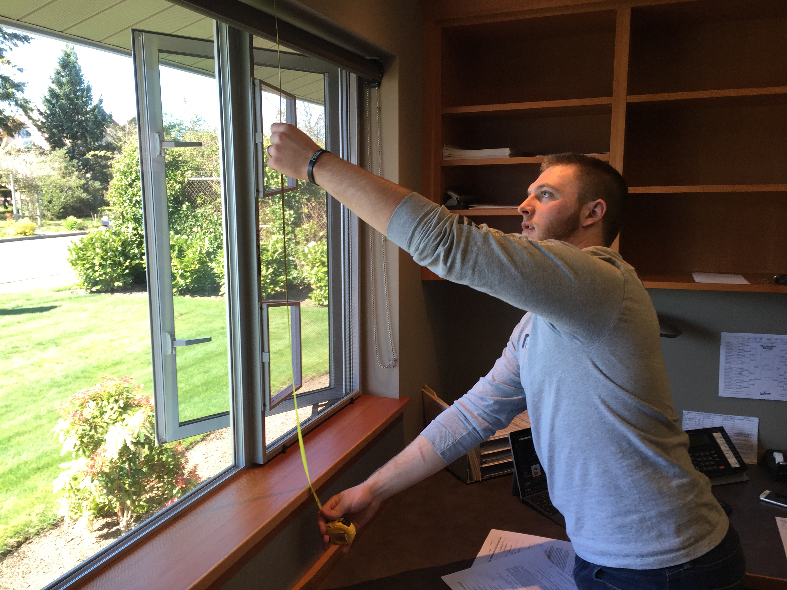
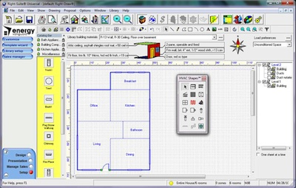
HOW FELLER WILL DETERMINE THE RIGHT SIZE SYSTEM FOR YOUR HOME
Measure – Heated Sq. Ft. window sizes, insulation values & load capacity of existing ductwork.
Accurately calculate the heating & cooling loads with WrightSoft software

Slide 11
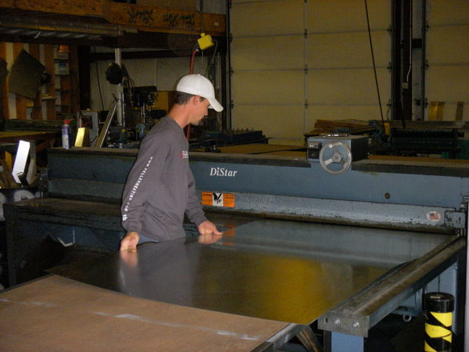
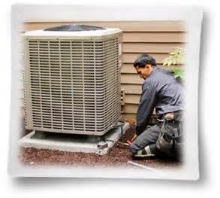
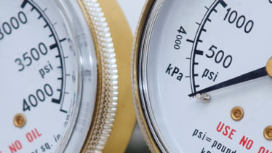
INSTALLATION
Layout & Fabrication
Removal and Installation
Fire off & test equipment
Step 1. is an onsite visit by our installer for measurements and then back to our shop for fabrication
Step 2. is the actual installation process. Generally this will take one to two days.
Step 3. A Feller Heating Technician will test all functions of your new equipment before leaving your home & make sure you understand how the system operates

Slide 12



Things You Need To Know
Permits
Electrical
Final Inspections
Feller Heating will purchase all required permits for installation of new equipment in your home. Generally this will consist of a Mechanical permit and in some cases a Class “B” low voltage permit for thermostat wiring.
Electrician cost and Permitting is not provided by Feller Heating. We do recommend:
JM Electric (360) 410-0328
Homeowner can also provide an electrician for the project.
Once your project is completed Feller Heating will send you your permit information along with a Phone # to call to set up a final Mechanical inspection.
Homeowner must be on site to meet inspectors for this final.

Slide 13


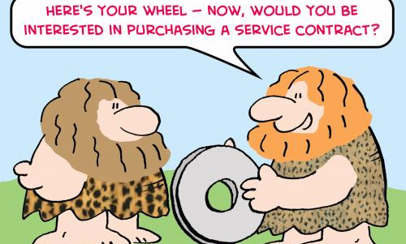
JOB COMPLETION
Rebates
Warranty
Service Contracts
Feller Heating will take care of all required paperwork for manufacturer and utility rebates. All you have to do is sign your name, it couldn’t be easier!
Feller Heating will submit and register your equipment with the manufacturer to ensure maximum warranty coverage on your purchase
We take a different approach to service contracts.
No financial obligation required.
Just sign an agreement and you will receive a 10% discount for a 3 year period & a 10% discount on any future repairs if needed.
You can opt out at any time.
We just want to keep this simple!

Slide 14
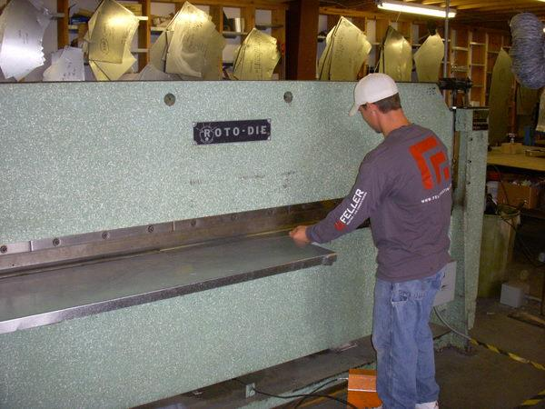
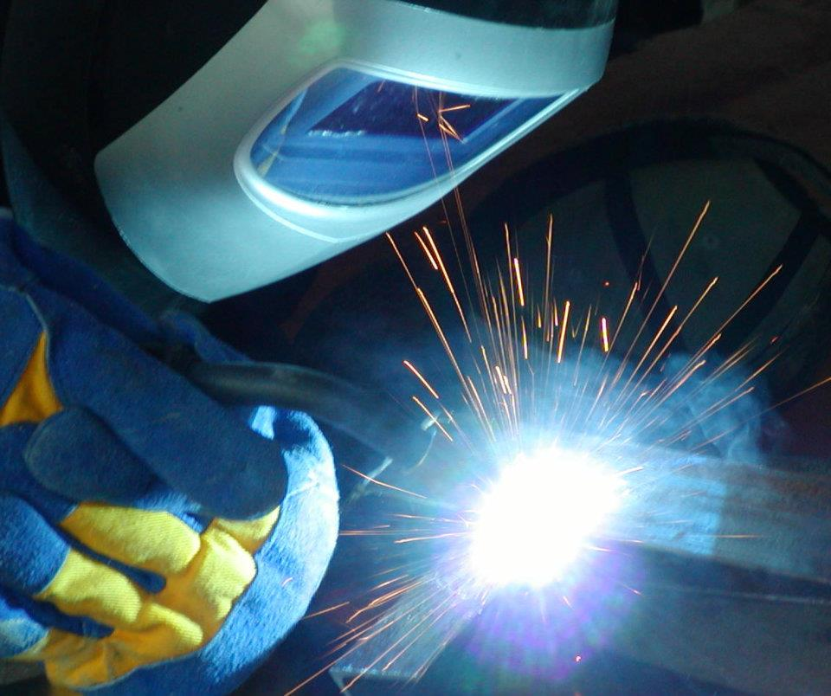
Fabrication Shop
Sheet Metal Fabrication
Welding

Slide 15



Staff Certifications & Ongoing Education
NATE Certified Service Technicians
Union Sheet Metal Installers
Estimators & Project Managers
Feller Heating residential & commercial installers are members of Local 66
Installers adhere to SMACNA installation & fabrication standards & participate in ongoing education & training making them some of the best our industry has to offer!
Our estimators & project managers use the most current technology available for our industry.
Ongoing in field training, classroom & manufacturer education keeps our staff in tune with the ever changing HVAC industry.
All Feller Heating Technicians are NATE certified and participate in regular ongoing education and service training

Slide 16
Feller Heating NATE Certified Service Technicians
Ron Bock / Mike Hopkinson / Tiffany Baker / Zach Johnson

Slide 17
Residential Installers:
Brian, Stevan, Alex, Cayle, and Mark

Slide 18

Office Administrator: Ashley Gray
Coordinates Service Techs
Process Warranties
Assist with utility & manufacturer rebates
Receives Payments
Sets Up Annual Service Contracts
Call her with any questions!

Slide 19
Accounting
Nancy Chen

Slide 20
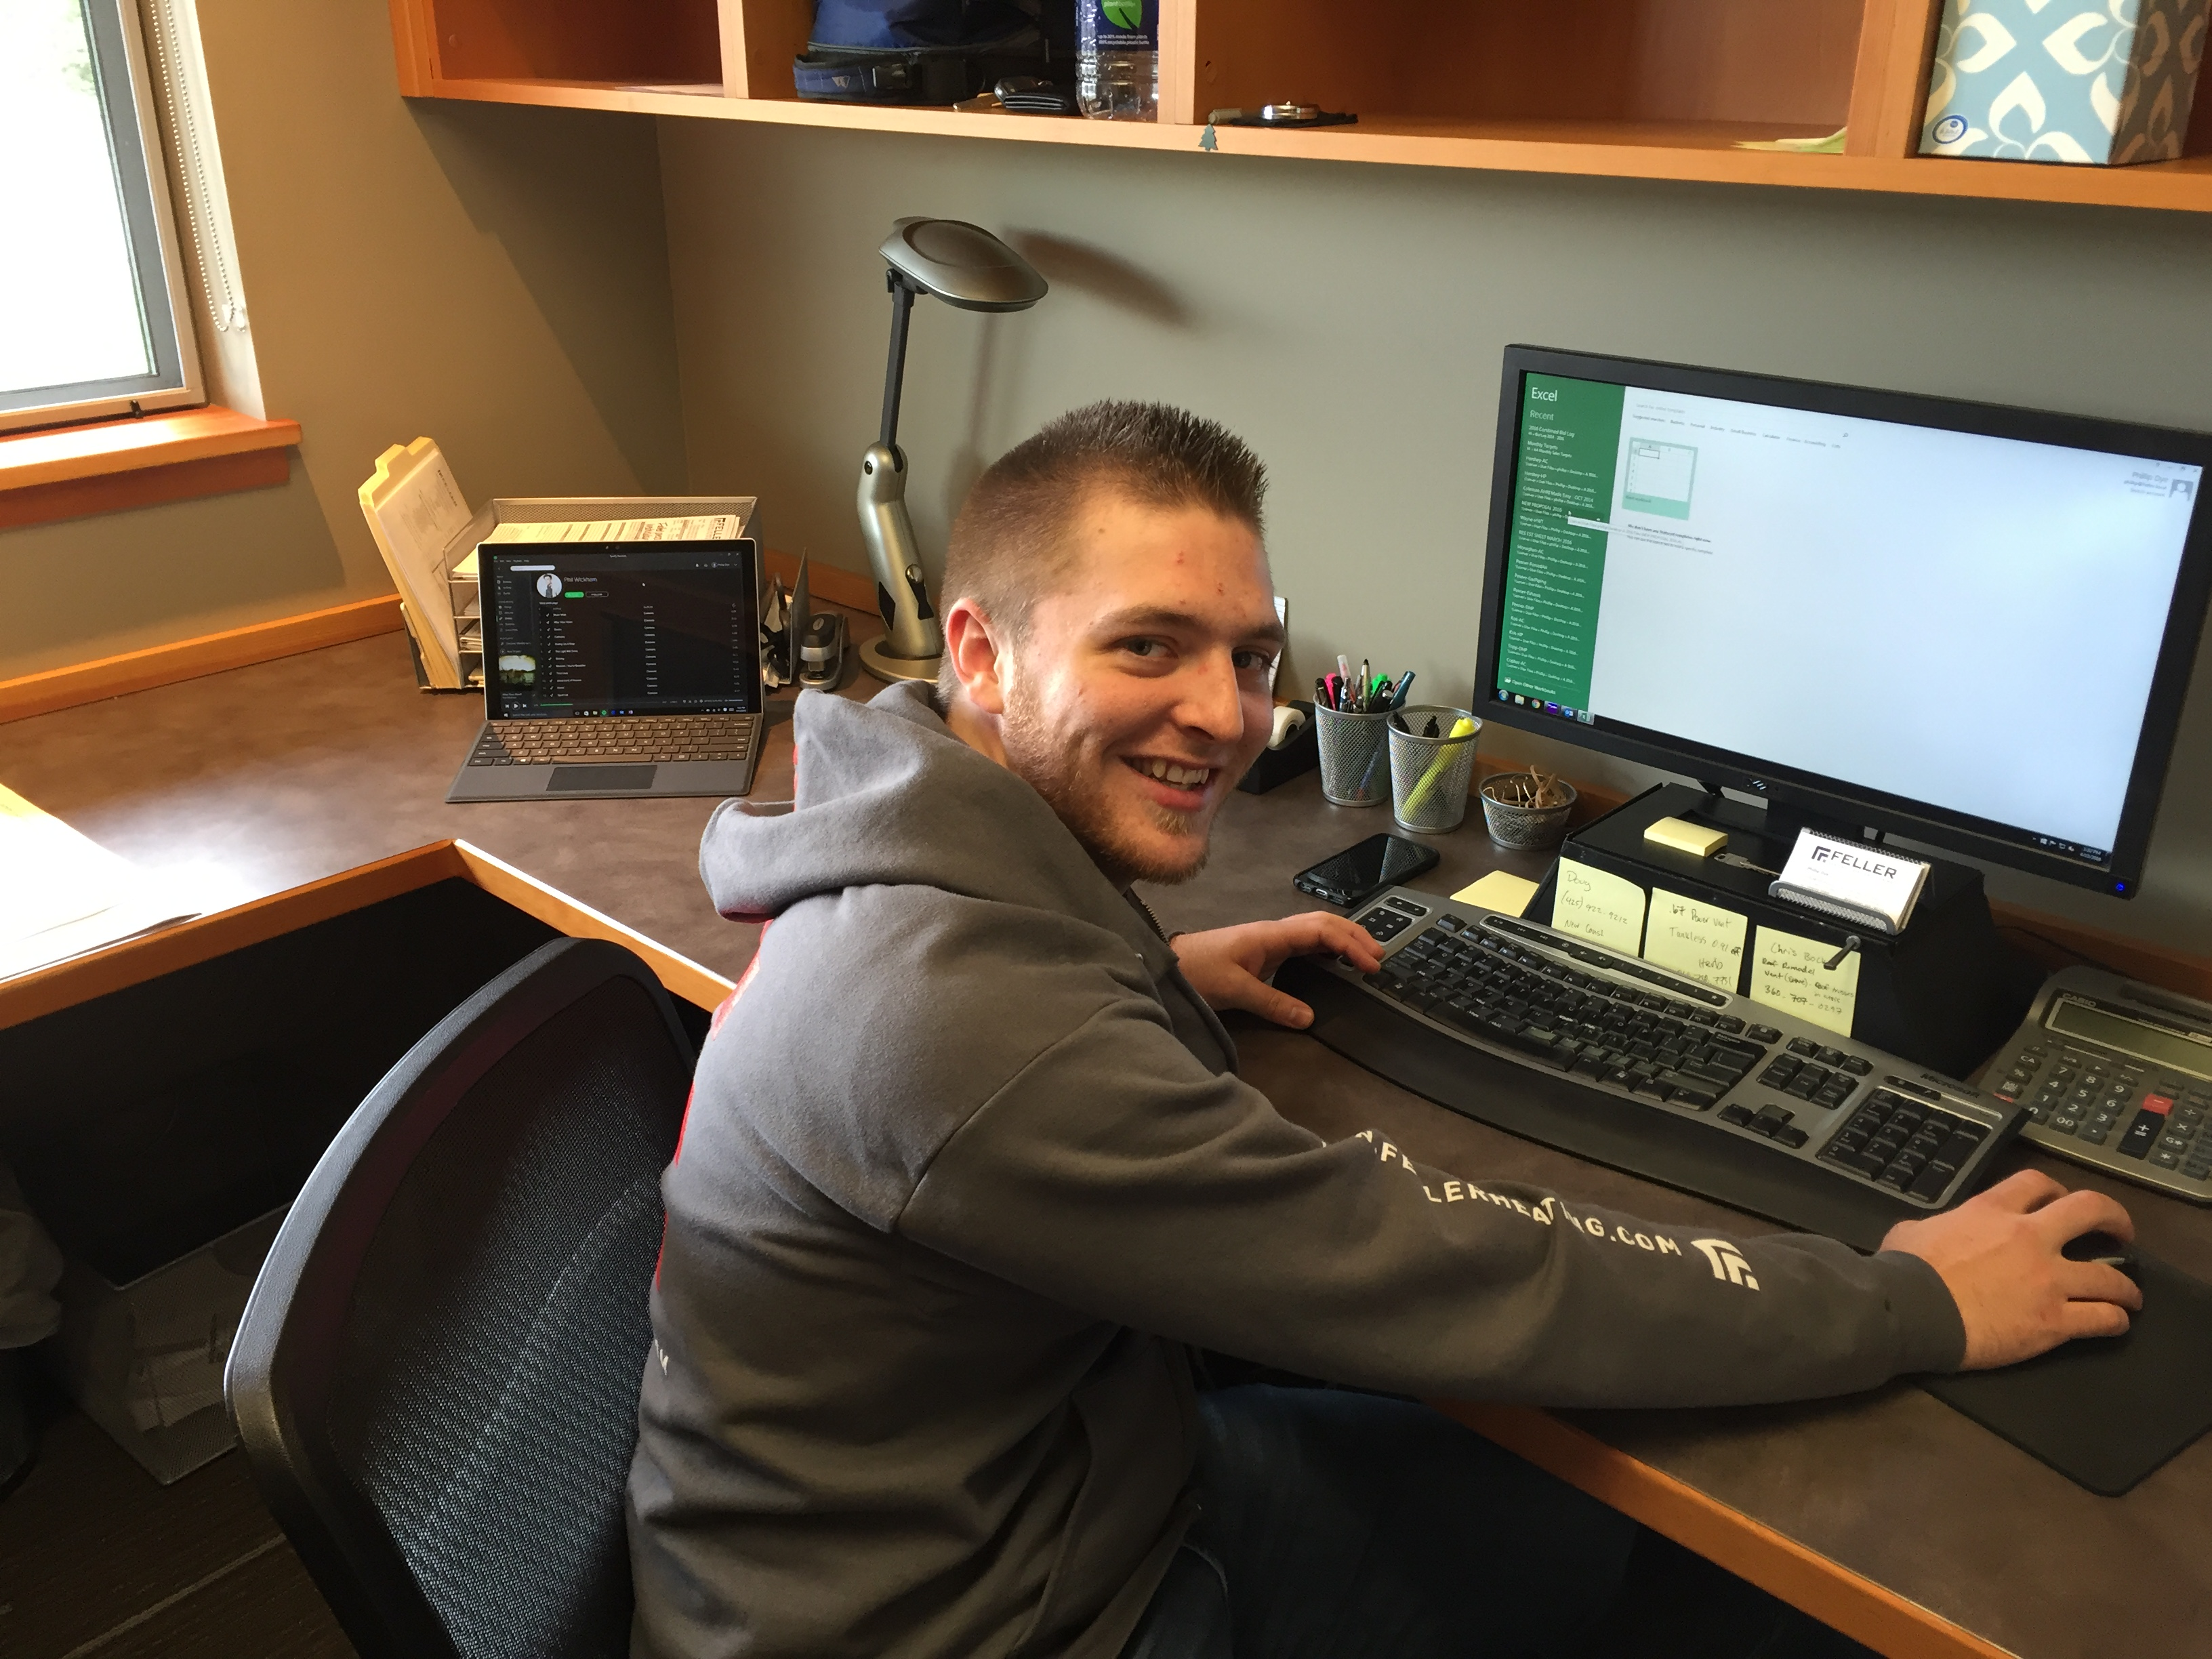
Residential Estimator & Project Manager – Phillip Dye

Slide 21
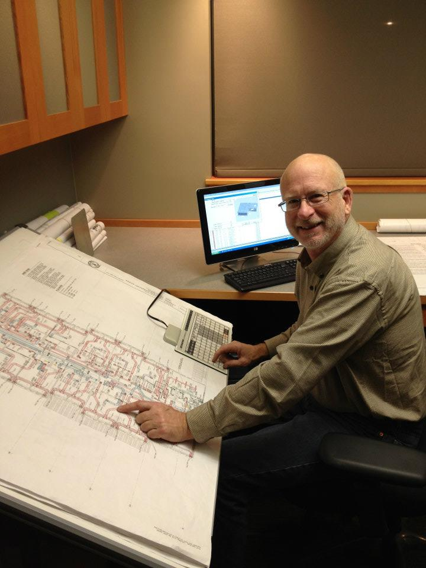
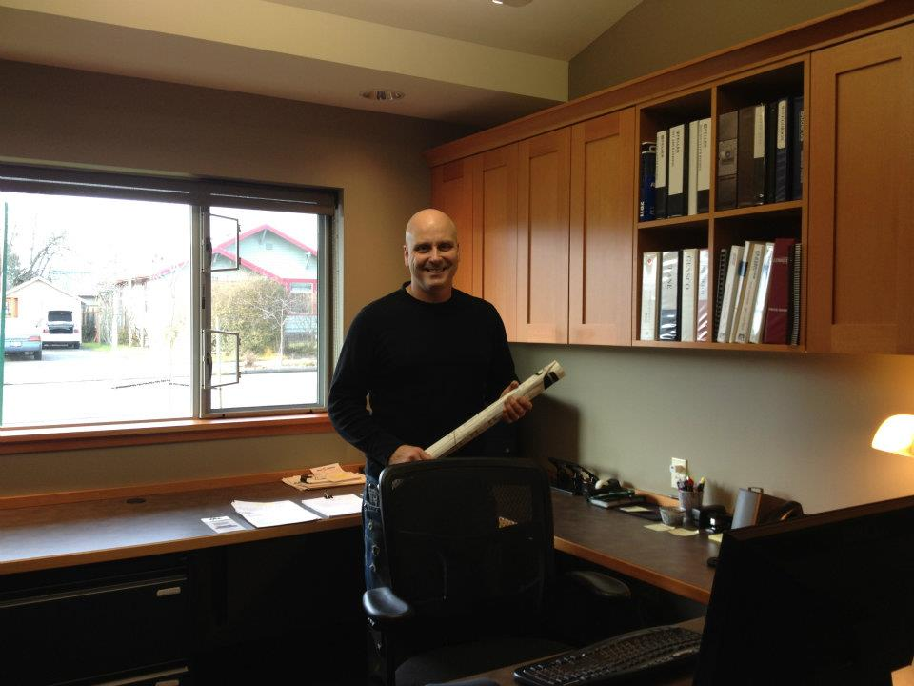

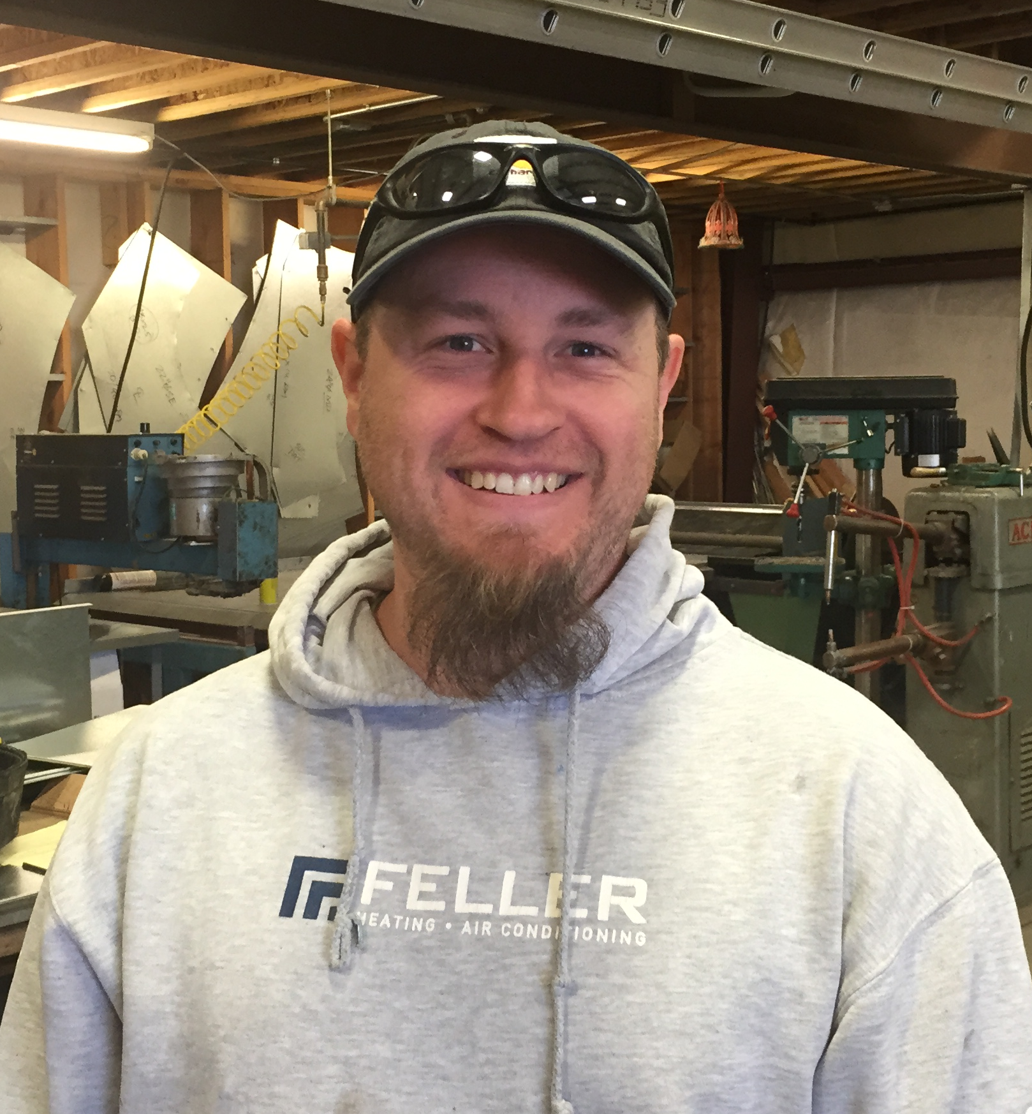
Management Team
Dan Tilton
John Larsen
Steve Felbinger
President
Vice President
Field Manager

Slide 22
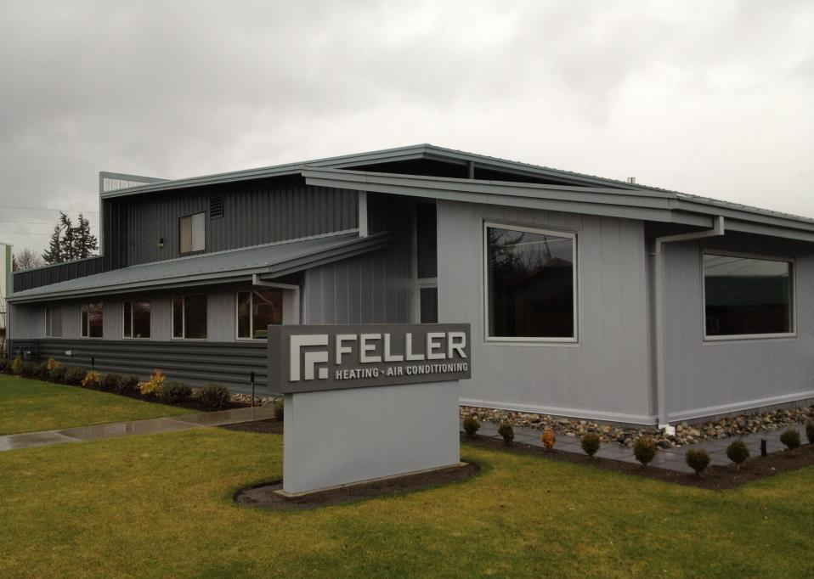
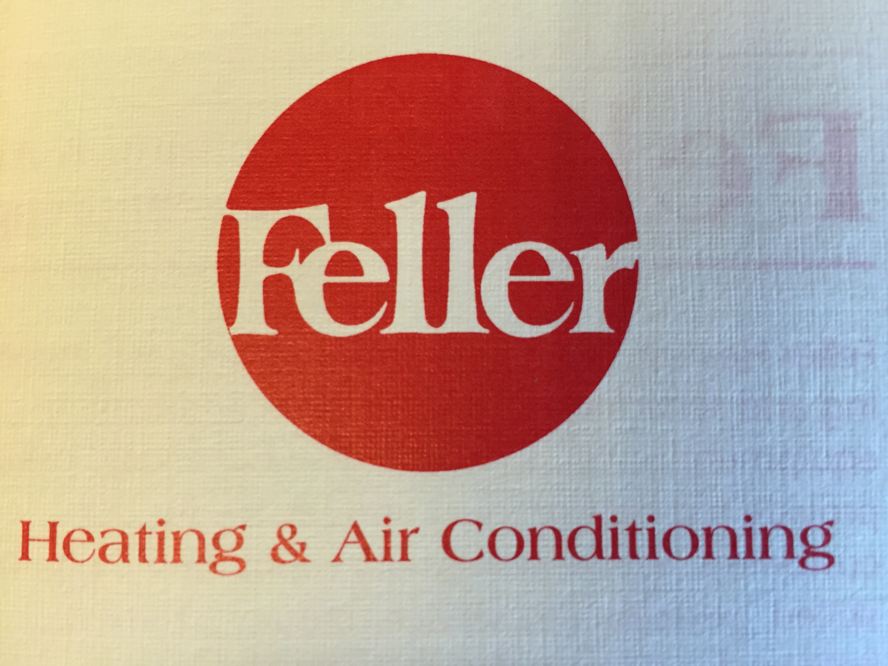
Our History – 40 Years Serving Whatcom, Skagit & Island Counties
Founded in 1979. Feller Heating gained a reputation for quality and integrity and that reputation continues today
Located at 501 Virginia St in Bellingham.

Slide 23
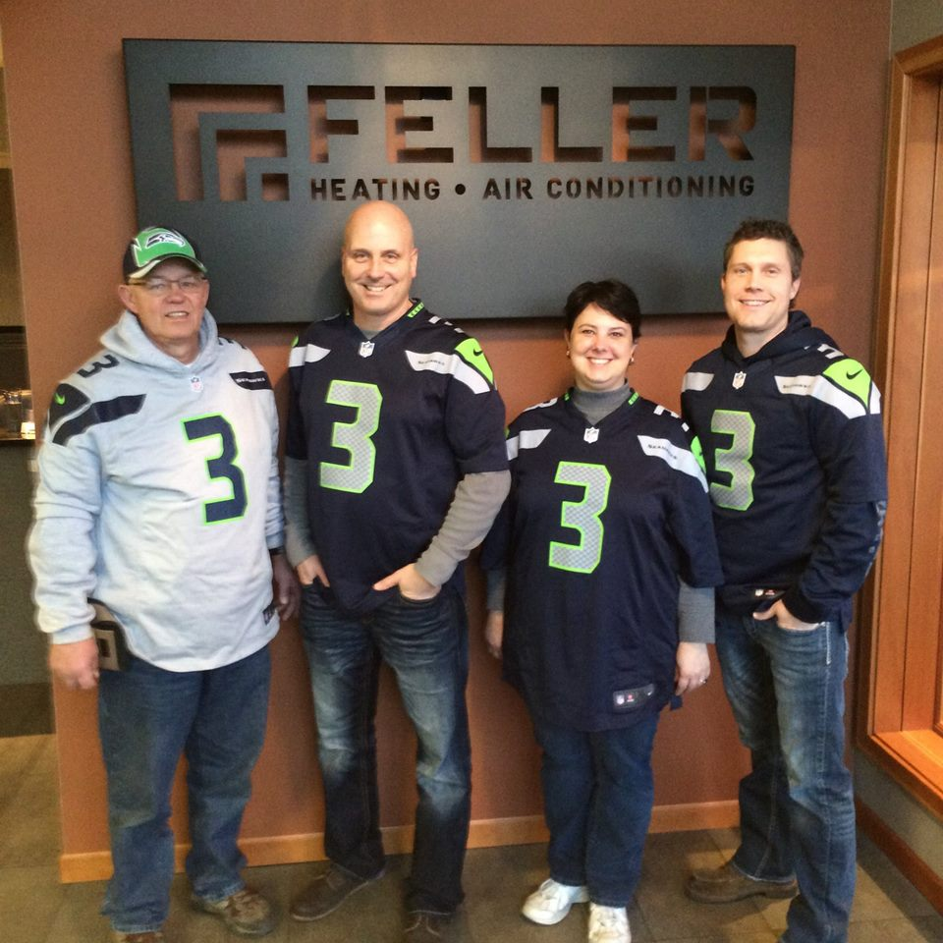
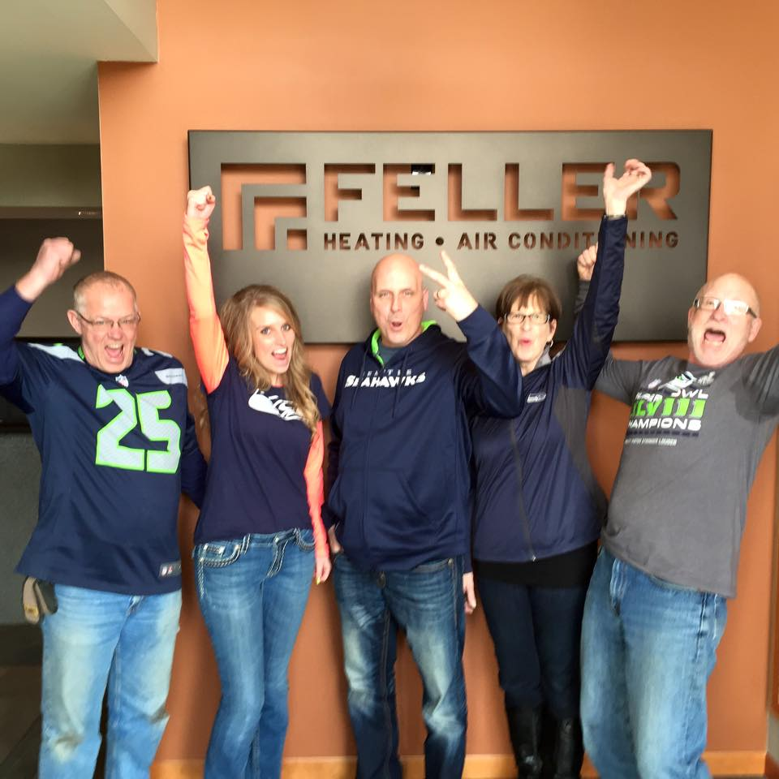

Most Important… We are Huge Seahawk Fans!
2013 Super Bowl Champs!
2014 – Super Bowl Hopefuls
2018-2019 Go Hawks!!

